Slide 1

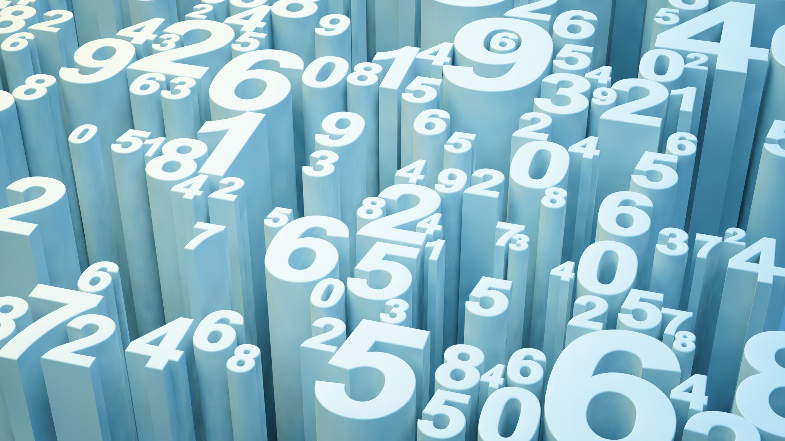
The Number System
Basics of computing

Slide 2
Learning Intention
At the end of the class, students will
  Understand why computers use binary to represent data
  Recognize our normal number system as the decimal or base 10
  Define the different units of data storage
  Convert numbers from binary to decimal

Slide 3
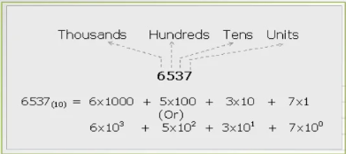
Digital Computer
In everyday life, we use numbers based on combinations of the digits between 0 and 9. This counting system is known as decimal or base 10.
Try this with 83678
And 98438

Slide 4
Digital Computer
Computers use 1s and 0s to represent the flow of electricity
1 is used to show the electricity is flowing, and 0 shows that it is not flowing.
All data we want to the computer to process must be converted into binary code (1s an 0s)
Each 1 or 0 in a binary code is a bit (binary digit). For example 1010 is 4 bits.

Slide 5

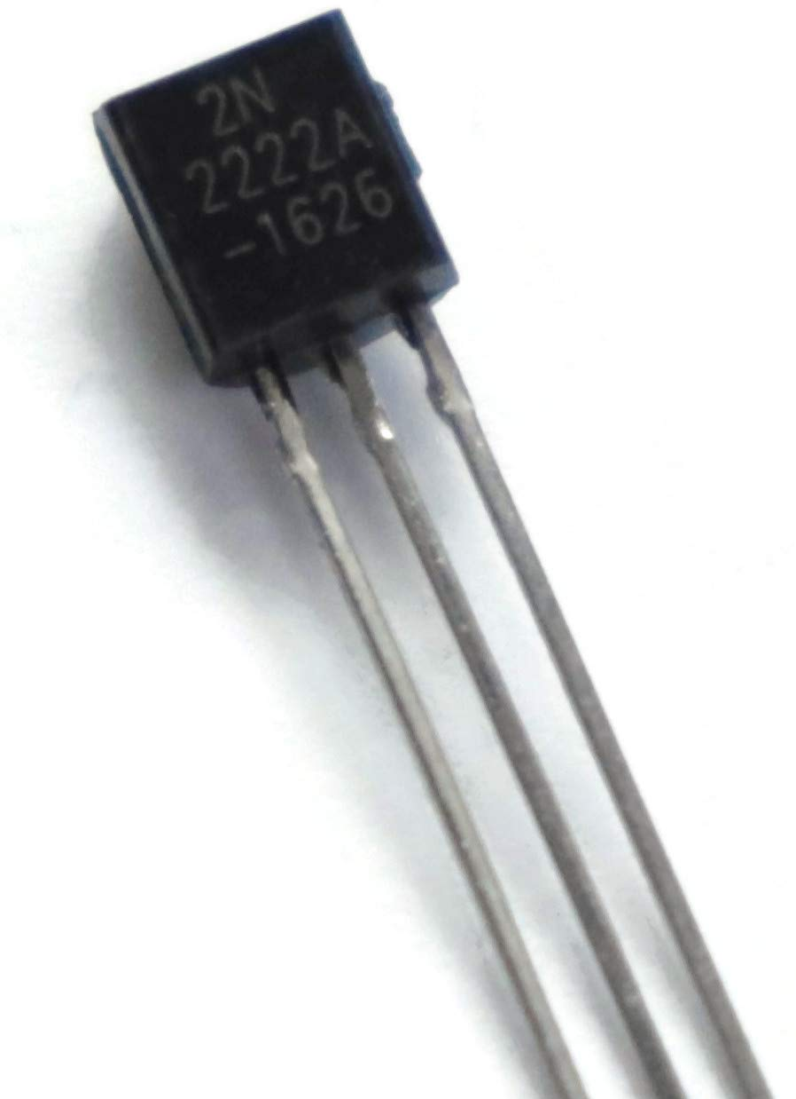
Digital Computer Transistors
The circuits in a computer's processor are made up of billions of transistors. A transistor is a tiny switch that is activated by the electronic signals it receives. The digits 1 and 0 used in binary reflect the on and off states of a transistor.

Slide 6
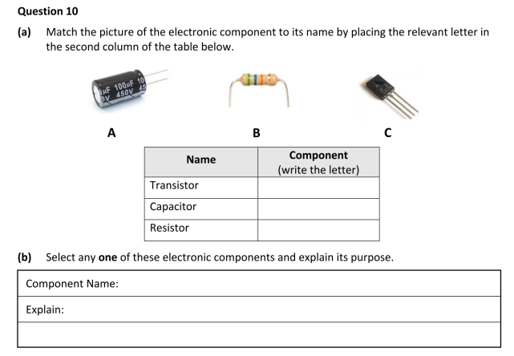
Leaving Cert Questions

Slide 7
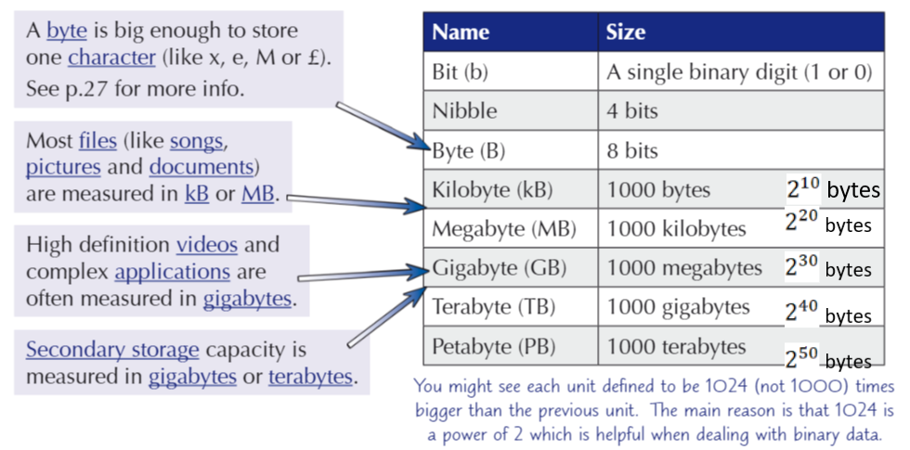
Sizes of other units of data

Slide 8
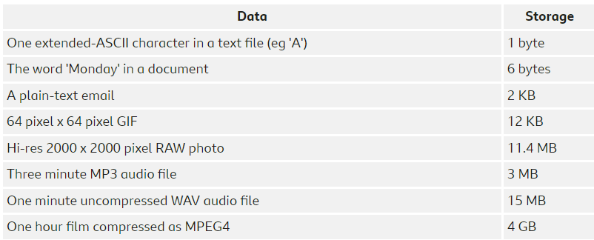
Sizes of other units of data
Different types of data require different amounts of storage space. Some examples of this follow

Slide 9

Data Representation
Each bit can take one of 2 different values (0 or 1).
The largest number that can be stored as a byte (8 bits) is 11111111 or 255 in decimal. This can be written as ${255}_{10}$
The smallest number that can be represented by a byte is 00000000 or 0 in decimal.
Therefore a byte (8 bits) can be used to store one of a total of 256 ($2^{8}$) different values
This means a nibble (4 bits) can take $2^{4}$ = 16 different values

Slide 10
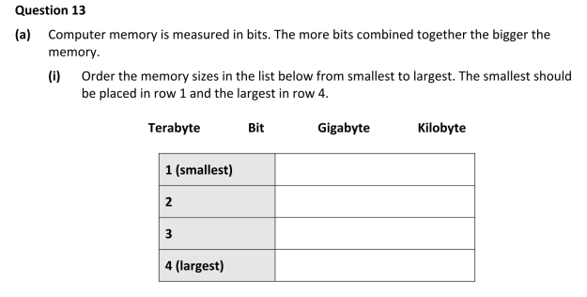
Leaving Cert Questions

Slide 11
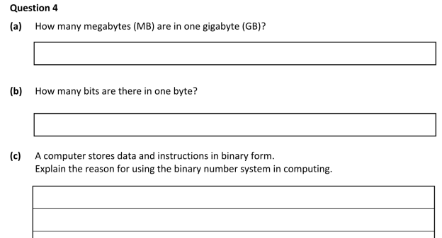
Leaving Cert Questions

Slide 12



Leaving Cert Questions

Slide 13
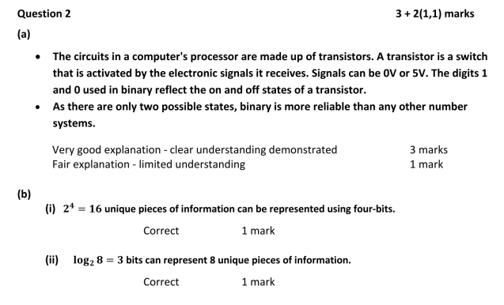
Leaving Cert Questions

Slide 14



Converting from binary to decimal
The position of each bit in a byte represents its place value
The first place value is the rightmost bit and is $2^{0}$
Power of 2 | $$2^{7}$$ | $$2^{6}$$ | $$2^{5}$$ | $$2^{4}$$ | $$2^{3}$$ | $$2^{2}$$ | $$2^{1}$$ | $$2^{0}$$
Place Value | 128 | 64 | 32 | 16 | 8 | 4 | 2 | 1
 | 0 | 1 | 0 | 0 | 0 | 1 | 1 | 0
${1000110}_{2}$ = 0x$2^{7}$ + 1x$2^{6}$ + 0x$2^{5}$ + 0x$2^{4}$ + 0x$2^{3}$ + 1x$2^{2}$ + 1x$2^{1}$ + 0x$2^{0}$
= 0 + 1x64 + 0 + 0 + 0 + 1x4 + 1x2 + 0
= ${70}_{10}$

Slide 15


Convert from binary to decimal
Power of 2 | $$2^{7}$$ | $$2^{6}$$ | $$2^{5}$$ | $$2^{4}$$ | $$2^{3}$$ | $$2^{2}$$ | $$2^{1}$$ | $$2^{0}$$
Place Value | 128 | 64 | 32 | 16 | 8 | 4 | 2 | 1
Convert ${10011011}_{2}$ to decimal
Convert ${11011}_{2}$ to decimal
Convert ${1001011}_{2}$ to decimal

Slide 16
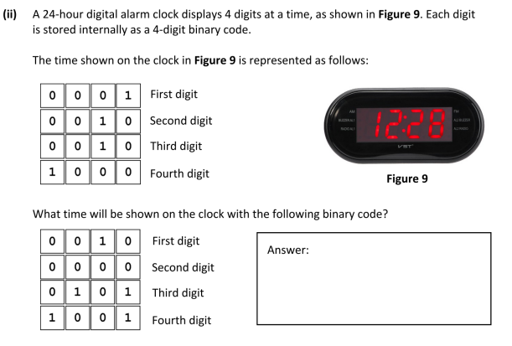
Leaving Cert Questions

Slide 17

Leaving Cert Questions

Slide 18
Convert from decimal to binary
Step 1: Divide the given decimal number by 2 and note down the remainder.
Step 2: Now, divide the obtained quotient by 2, and note the remainder again.
Step 3: Repeat the above steps until you get 0 as the quotient.
Step 4: Now, write the remainders in such a way that the last remainder is written first, followed by the rest in the reverse order.

Slide 19
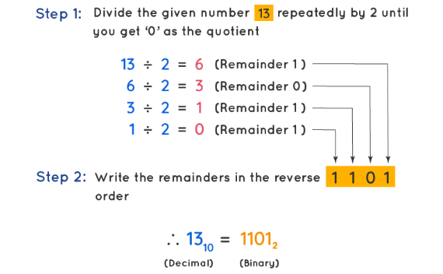
Convert from decimal to binary
Example: Convert the decimal number 13 to binary.
Solution: We will start dividing the given number (13) repeatedly by 2 until we get the quotient as 0. We will note the remainders in order.

Slide 20







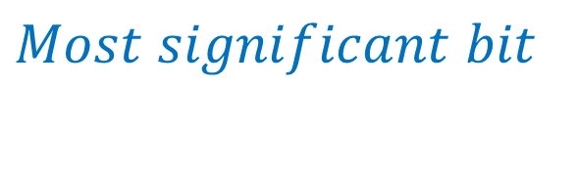








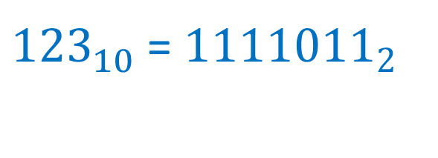
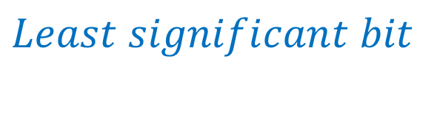







Convert from decimal to binary
$$Least significant bit$$
Example: Convert the decimal number 123 to binary.
Solution: We will start dividing the given number (123) repeatedly by 2 until we get the quotient as 0. We will note the remainders in order.
Video on converting decimal to binary
${123}_{10}$ = ${1111011}_{2}$
$$Most significant bit$$

Slide 21
Practice time –
Convert the following decimal numbers to binary
67
92
110
59

Slide 22
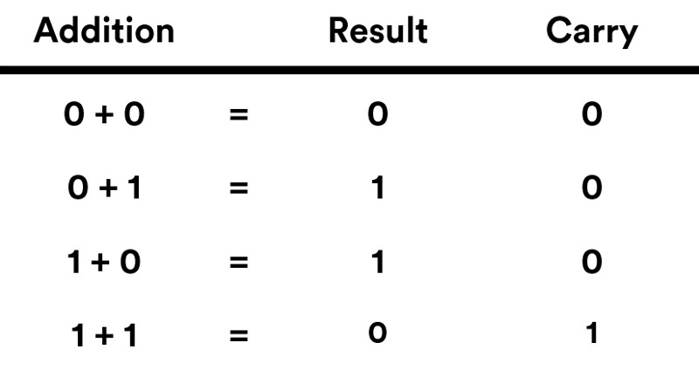
Binary Addition

Slide 23
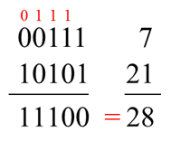
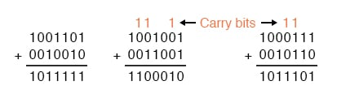
Binary Addition
Video binary Addition

Slide 24
Practice time –
Add the following binary numbers
1101 + 1010
1110001 + 10001
11010 + 110011

Slide 25
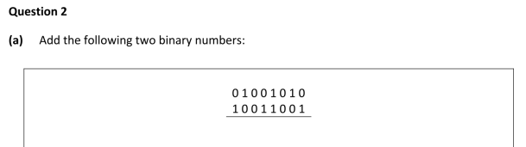
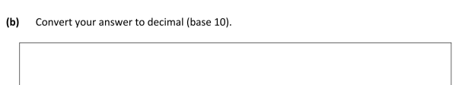
Leaving Cert Questions

Slide 26
Overflow Errors –
Sometimes, during binary arithmetic you will get a result that requires MORE bits than the CPU is expecting – this is called OVERFLOW.
E.g. the 8 bit calculation 11111111 + 00000001 gives the 9-bit answer 100000000. Computers will see the 1 as an overflow error and just output 00000000 as the result, which is nonsense.

Slide 27
Overflow Errors –
Computers usually deal with these extra bits by storing them elsewhere. Overflow flags are used to show an overflow error has occurred
Overflow errors lead to a loss of data and a loss of accuracy in your answer. It can also cause software to crash if it doesn’t have a way of dealing with the extra bit.

Slide 28
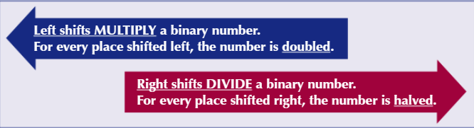
Binary Shift –
A binary shift moves every bit in a binary number to the left or right a certain number of places
Gaps at the beginning or end are filled in with 0s
The direction of the binary shift indicates whether it multiplies or divides the binary number.

Slide 29

Binary Shift –
If a number is shifted 3 places right, it will be halved 3 time (i.e. divided by $2^{3}$ = 8)
If a binary number were shifted 4 places left, it would be doubled 4 times (multiplied by $2^{4}$ = 16)
Left shifts can cause overflows (if extra bits are needed) and right shifts cause bits to “drop off” the end. Bits dropping off

Slide 30
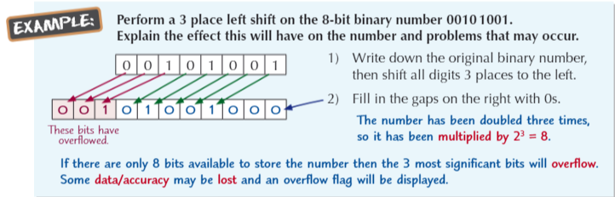
Example of Binary Shifts –

Slide 31
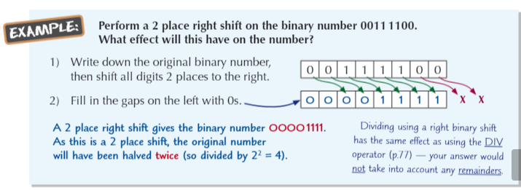
Example of Binary Shifts –

Slide 32
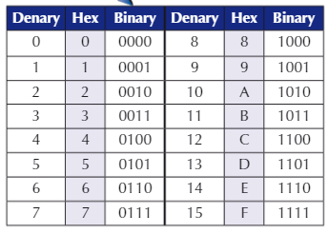
Hexadecimal code
Hexadecimal code or “Hex” are base 16 numbers
We use 0-9 for the 1st 10 digits and then A-F as the symbols for the other 6. All hexadecimal numbers are made of a combination of these digits.

Slide 33
Hexadecimal code
Hexadecimal or base 16 uses 16 different digits
A single hex character can represent any decimal number from 0 – 15
To represent 0 – 15 in binary requires 4 bits (nibble), so each hex character equates to a 4 bits in binary
Programmers prefer hex when coding
because – its simpler to remember large
numbers in hex (they’re shorter)
- It’s easier to convert between binary
and hex than binary and decimal.

Slide 34

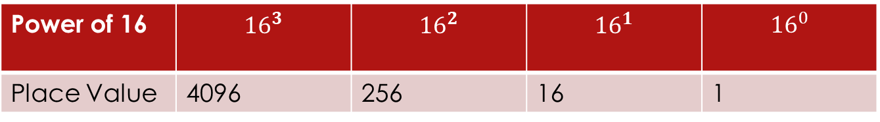
Converting from Hexadecimal to Decimal code
Power of 16 | $${16}^{3}$$ | $${16}^{2}$$ | $${16}^{1}$$ | $${16}^{0}$$
Place Value | 4096 | 256 | 16 | 1
Convert ${34BA}_{16 }$to decimal
= (3 x 4096) + (4 x 256) + (11 x 16) + (10 x 1)
= ${13498}_{10 }$
Convert ${19C2}_{16 }$to decimal
= (1 x 4096) + (9 x 256) + (12 x 16) + (2 x 1)
= ${6594}_{16 }$

Slide 35
Converting from Decimal to Hexadecimal
Similar to method for converting decimal to binary.
Step 1: Divide the given decimal number by 16 and note down the remainder.
Step 2: Now, divide the obtained quotient by 16, and note the remainder again.
Step 3: Repeat the above steps until you get 0 as the quotient.
Step 4: Now, write the remainders in such a way that the last remainder is written first, followed by the rest in the reverse order.

Slide 36























Converting from Decimal to Hexadecimal
Convert ${318}_{10 }$to hexadecimal

Slide 37
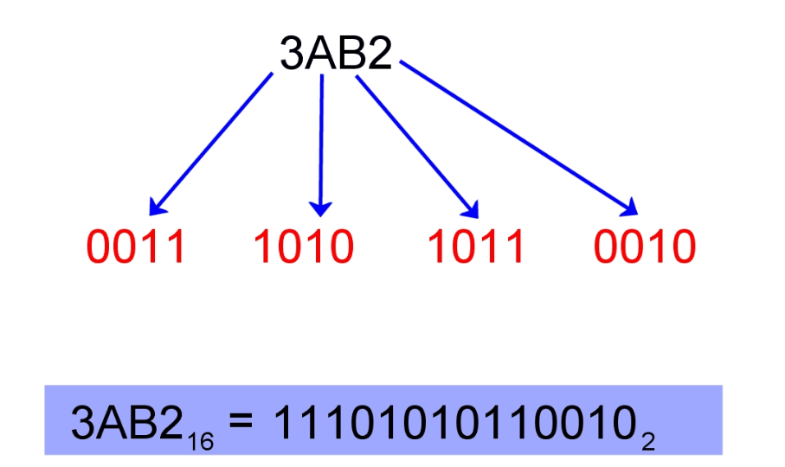
Converting from Hex to binary
Hex is very easy to convert to binary.
Write down the hex number and represent each hex digit by its binary equivalent number from the table above.
Use 4 digits and add insignificant leading zeros if the binary number has less than 4 digits. E.g. Write 10₂ (2 decimal) as 0010_{2.}
Then concatenate or string all the digits together.
Discard any leading zeros at the left of the binary number.

Slide 38
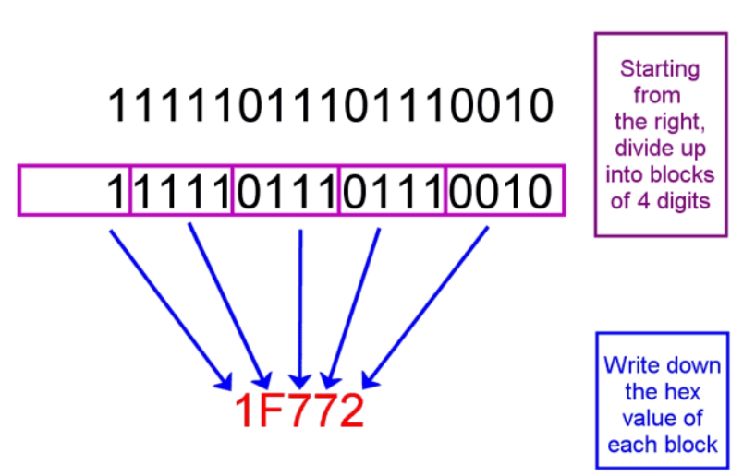
Converting from binary to hex
Start from the least significant bit (LSB) at the right of the binary number and divide it up into groups of 4 bits.
Convert each group of 4 bits to its equivalent hex value.
Concatenate the results together, giving the total hex number.

Slide 39
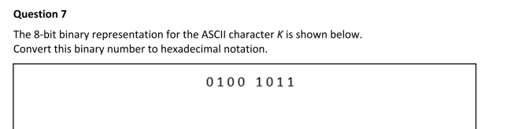
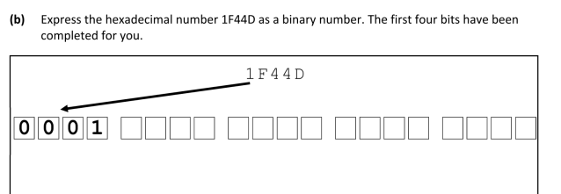
Leaving Cert Questions

Slide 40
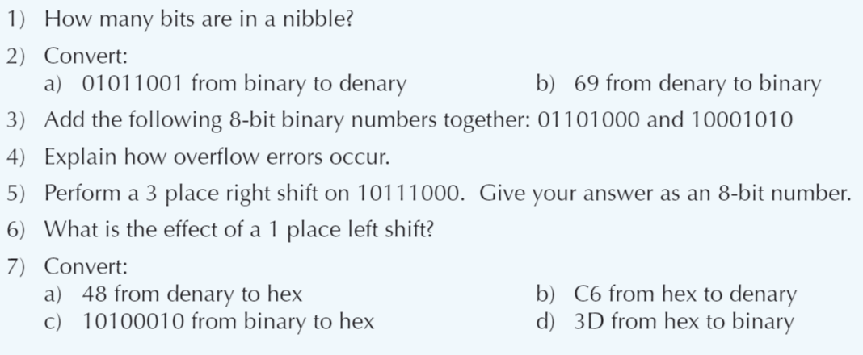
More Practice Questions

Slide 41
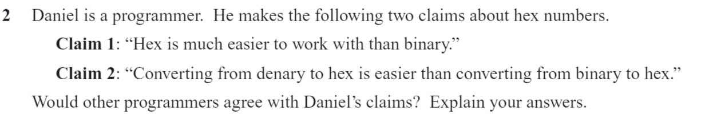
More Practice Questions

Slide 42
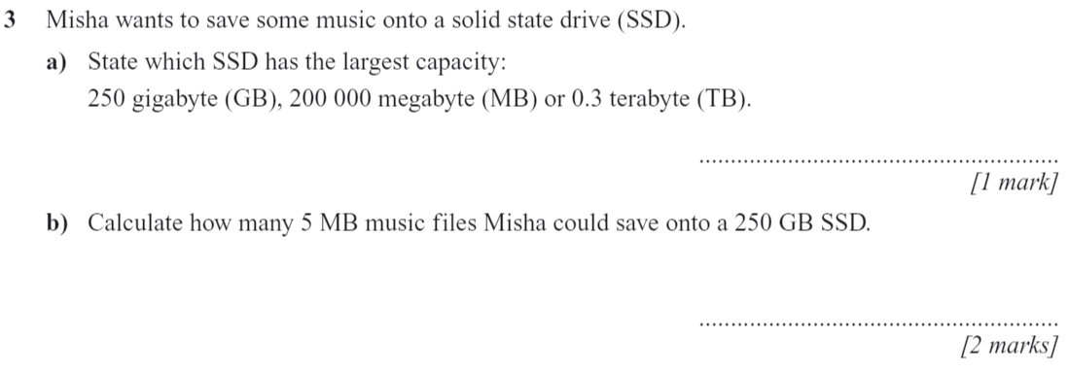
More Practice Questions

Slide 43
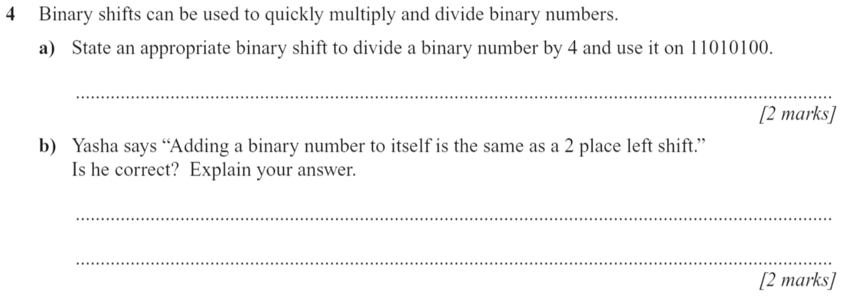
More Practice Questions

Slide 44
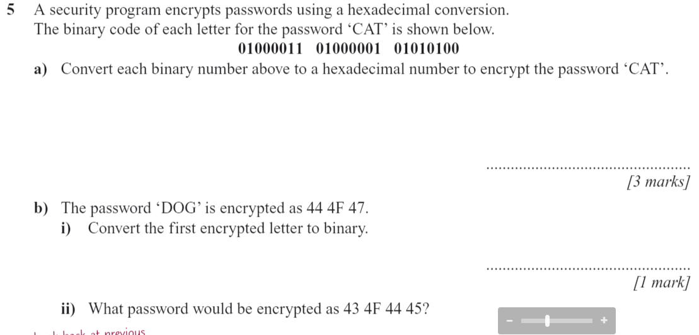
More Practice Questions

